Slide 1
Construct 2 Mini-game Ver2.0
Zhai
Notes:
Set the mood in the first slide, attract the audience
Use custom font
Use background

Slide 2
Basic Rules
Goal: Players try to collect as many star as they can in limited time.
When the player starts moving, the whole scene will be totally DARK !
Players can only see the character & its surroundings
And then whenever the character collects a star
A new star appears
&
The scene is lightened for 1 second
Or until character moves again.

Slide 3

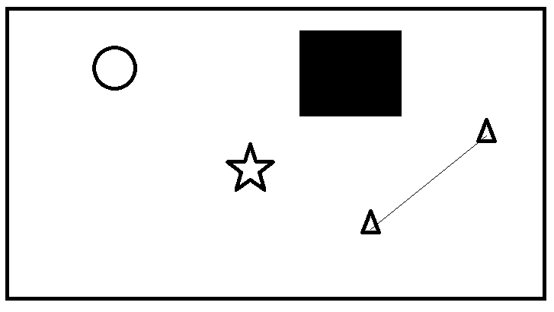
Scene
Vertical Camera
8-Direction
Character
Obstacle
Star
Portal

Slide 4
Control
The circle represents the character.
Character is what players can control.
The control method is normal 8-direction.
Remember character and its surroundings
are the only things players can see in the darkness

Slide 5
Mechanics
Obstacle is solid
and character
can’t surpass.
When character collects a star the whole scene lights up until the character moves again.
And a new star appears.
When character hits the Portal, it will be teleported to the pair portal.
And portal is a 2-way portal.
When character moves go out of the boundary, it will appear just on the other side of the layout

Slide 6
Mechanic
From the starting, the whole scene is visible
Then
IF
Then
Character
start moving

Slide 7
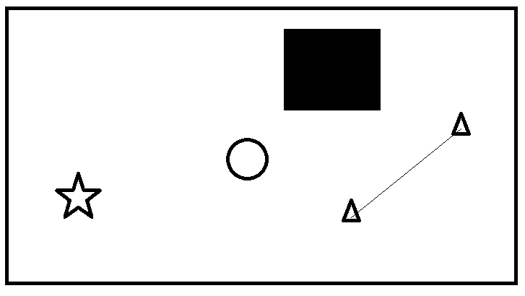
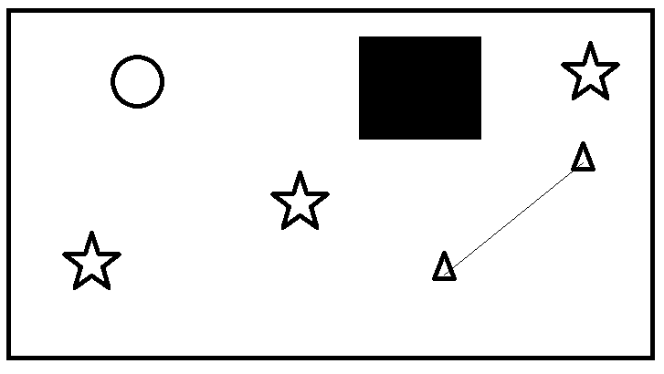
Mechanic
They will give some feedback when character hit them
Players can see the whole scene
And a new star appears
Feedback
Then
IF
Feedback
(Move again)

Slide 8



Mechanic - Feedback
They will give some feedback when character hit them
1.Shows in the
middle of the screen.
2.And transform from
little to big(animation)
Feedback
Obstacle
Feedback
Portal
1.Shows in the middle of the screen.
2.And transform from left to right(animation)
p.s. This animation should be very fast

Slide 9

Mechanic
About some global variable
Star Counter counts the stars player has collected.
When it equals to the number of the stars, the level is cleared.
Star Counter
0
Timer
Timer records the time
player has spent in this level
12:00

Slide 10
Mechanic & Intention
Leisure
Fast
Star
Collected
Congratulation!
After the players collected all the stars, they clear the level
a congratulation scene shows the time record
Another
Try?
The level design may be skipped by assigning the items randomly
(Not in Prototyping)

Slide 11
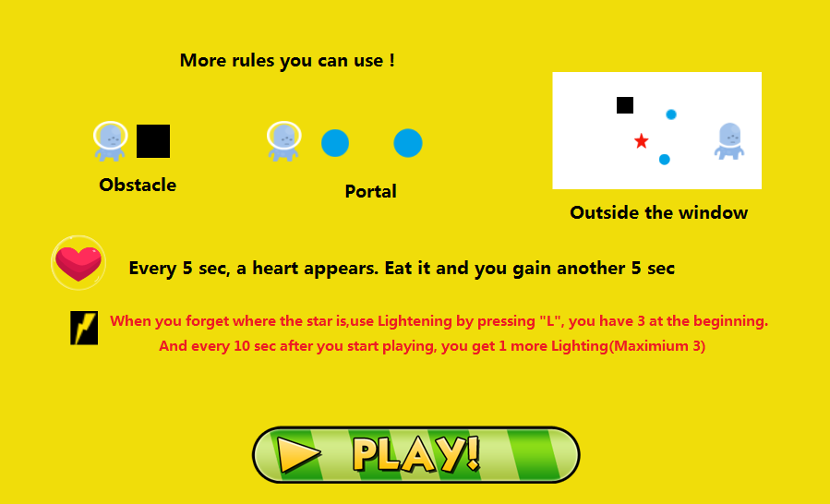
Updated Version

Slide 12
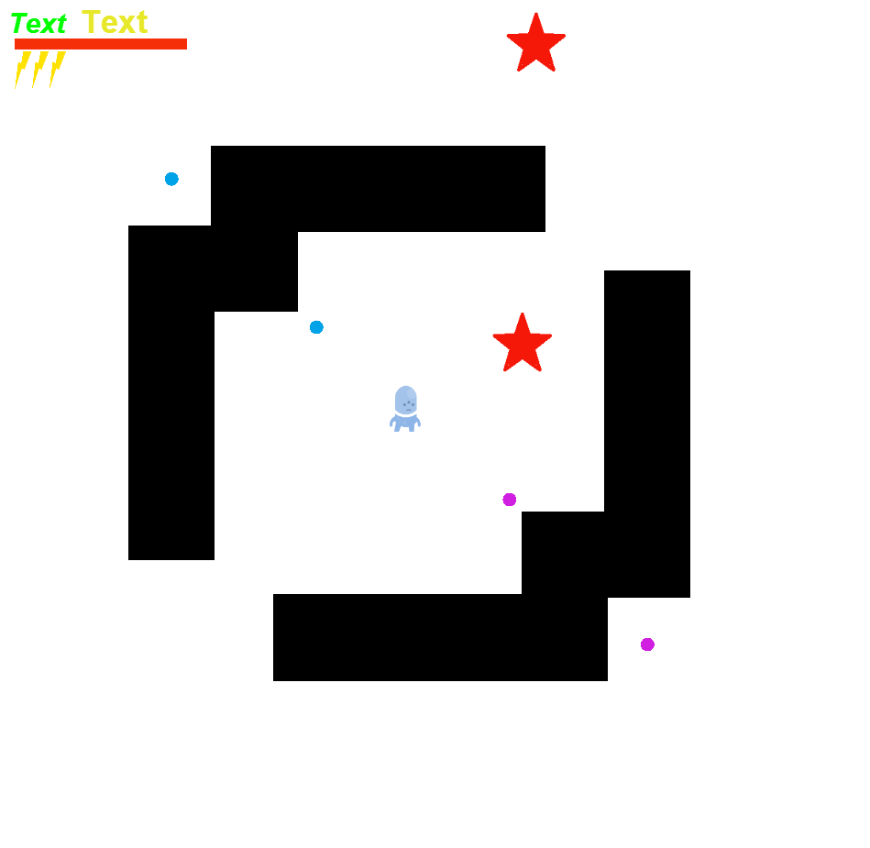
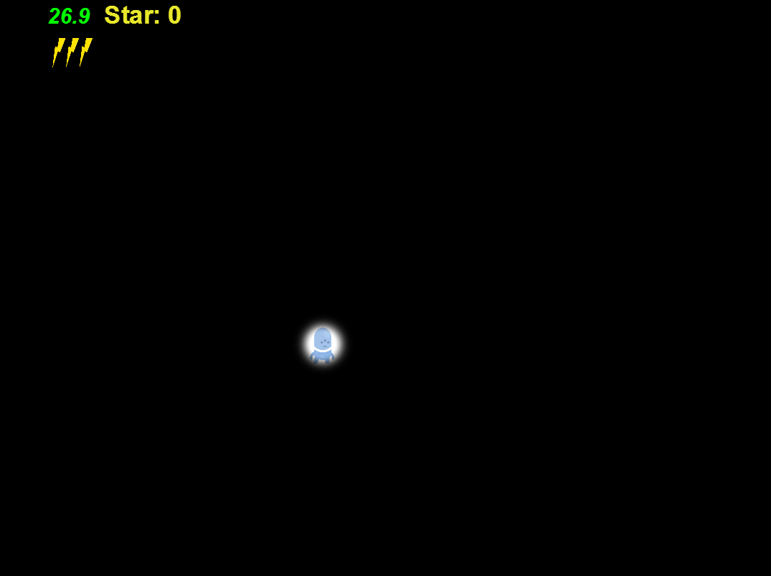
Updated Version

